Slide 1
PRESENTATION TITLE
Jullian Man hin Leonard
Shariffin

Slide 2


AGENDA
INTRODUCTION
Tasks
SUMMARY

Slide 3

INTRO
You are a DevOps Engineer, tasked to build a CI/CD pipeline for Company ABC in stages of integrating, testing and deploying a python script developed for the purpose of system monitoring. Installation of certain application will be done through usage of provisioning tool Ansible. The running of CI/CD tools Jenkins will be done through the launch of container and manage using orchestration tool Kubernetes.

Slide 4
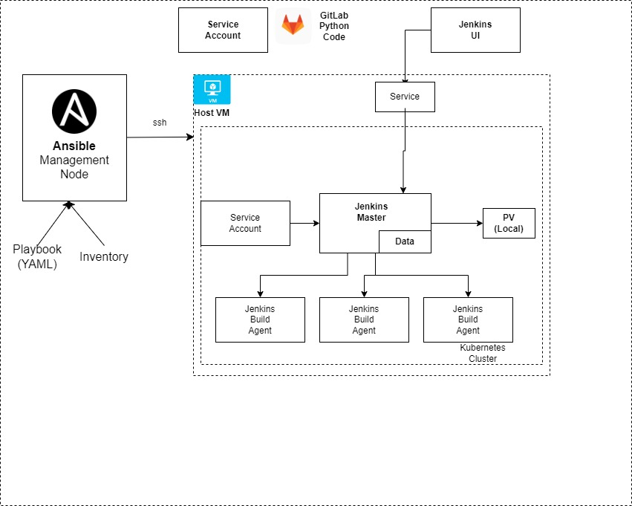
Diagram of the Project

Slide 5
Task 1: Install ansible for configuration management to install docker.

Slide 6
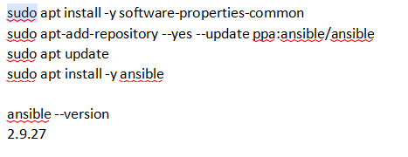
Task 1 : installing Ansible rhel commands summary

Slide 7
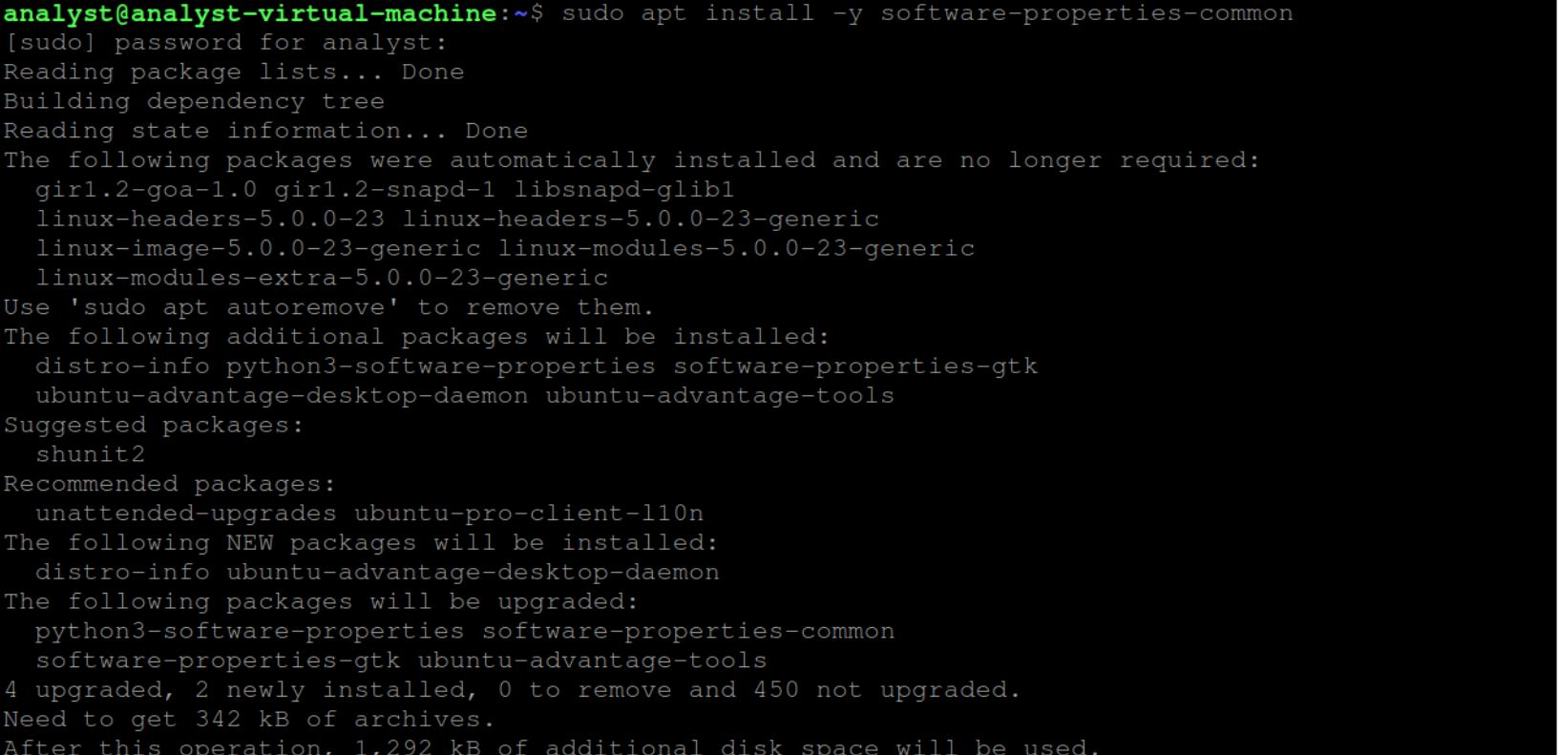
Task 1: Install ansible
Installs essential software properties required for managing external repositories on your Linux system.

Slide 8
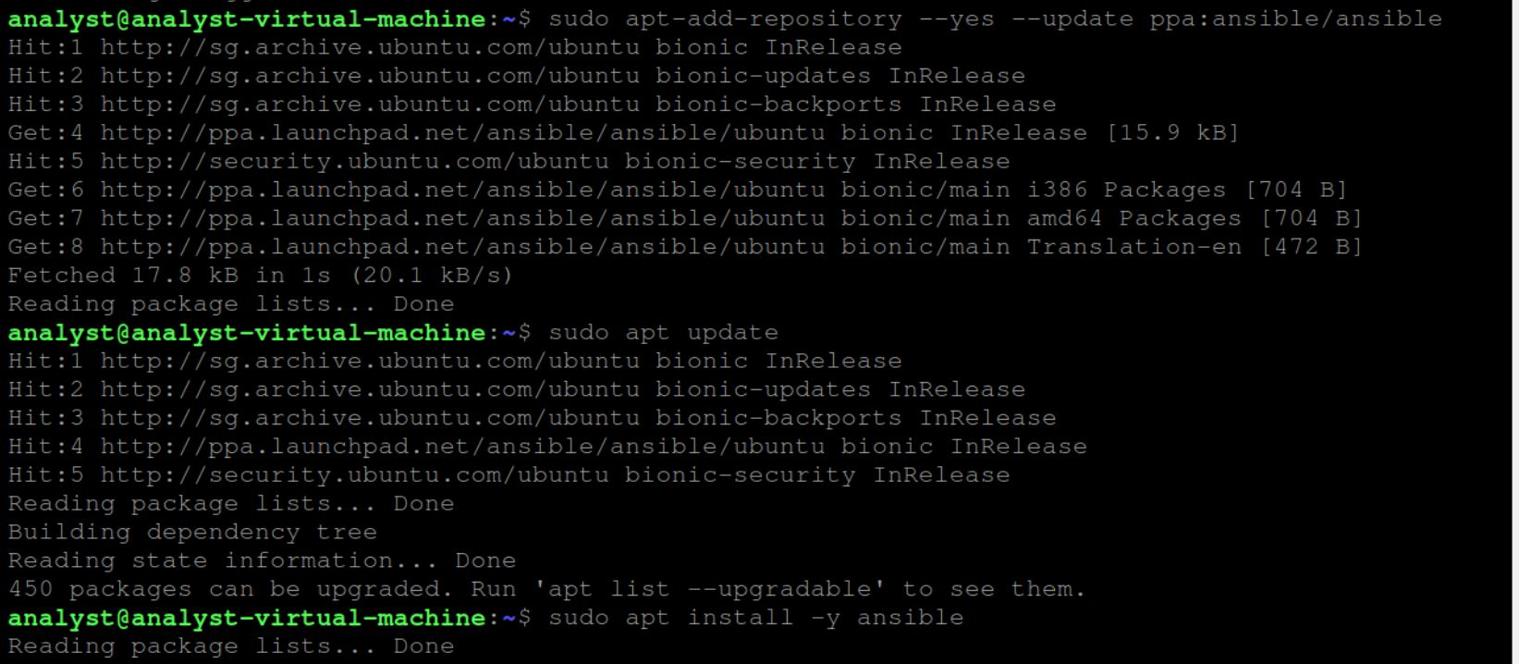
Task 1: Install ansible
Adds the Ansible repository, updates package information, and installs Ansible, an automation tool.

Slide 9
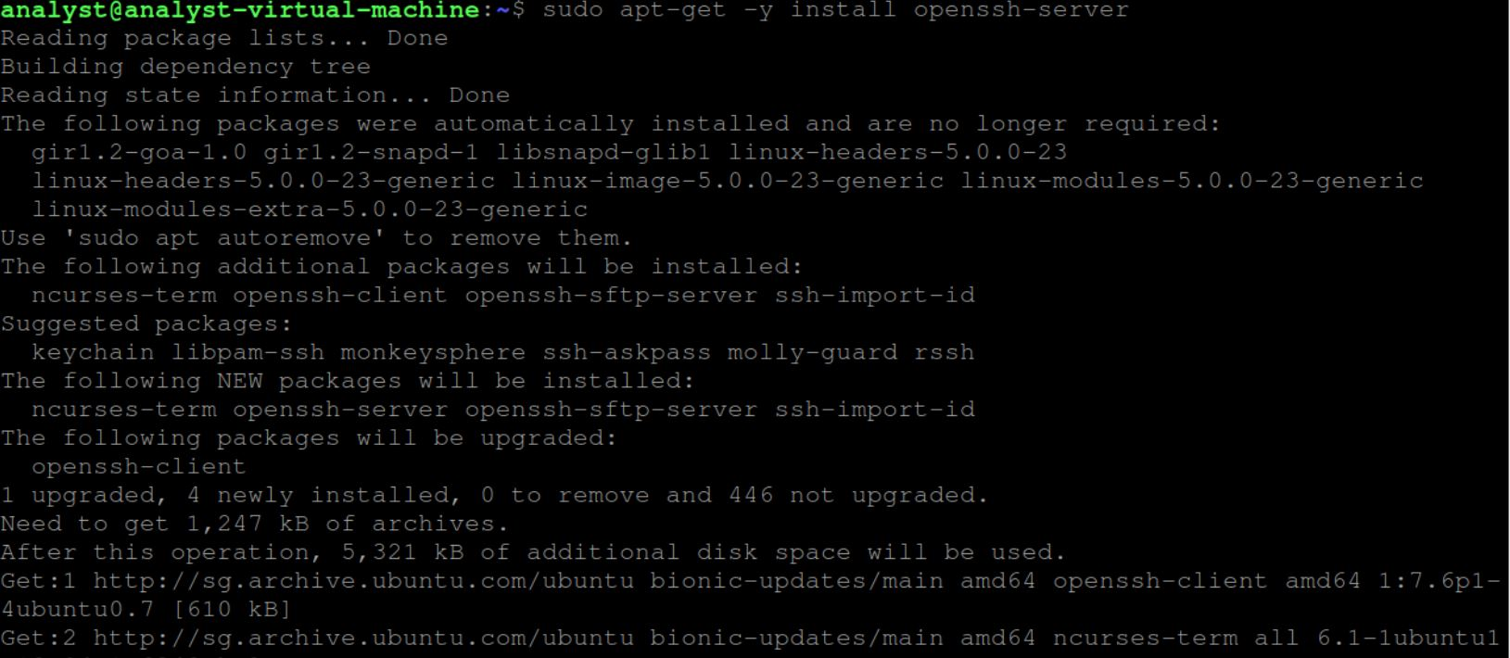
Task 1-2:Installing openssh-server for configuration management
Installs the OpenSSH server on your Linux system.

Slide 10
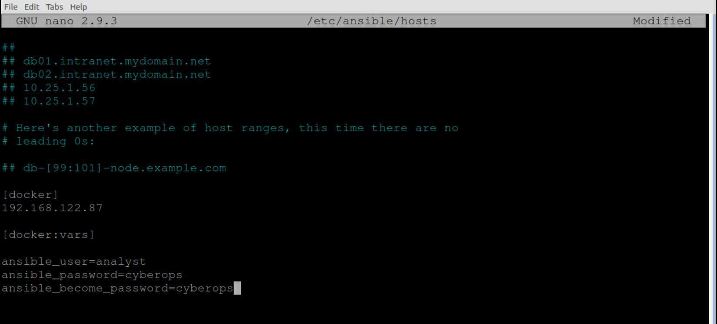
Task 1-3: setting up hosts
Configures Ansible to manage hosts in the "docker" group with specific connection and authentication details.

Slide 11
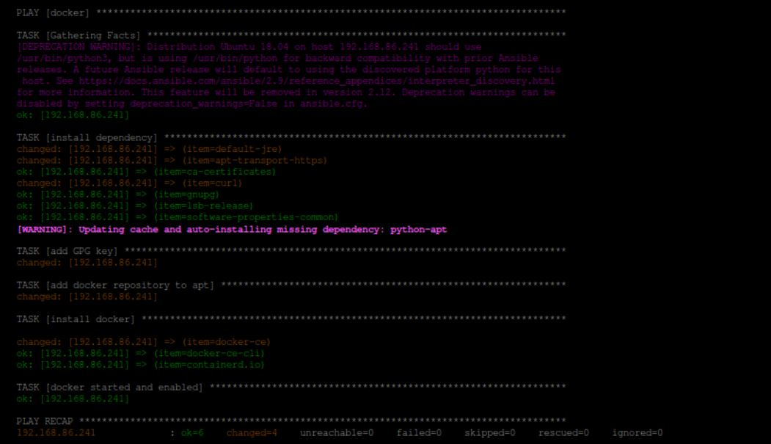
Task 1-4: Running Ansible Playbook for Docker Installation
Initiates the execution of Ansible tasks defined in the "docker-install.yaml" playbook.

Slide 12
Task 2: install a single kubernetes cluster

Slide 13
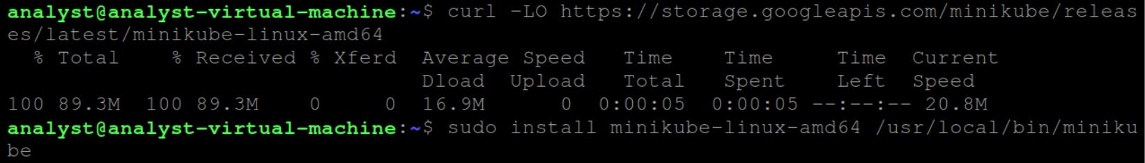
Task 2-1: Downloading Minikube Binary
Downloads the Minikube binary for Linux to facilitate Kubernetes cluster management

Slide 14
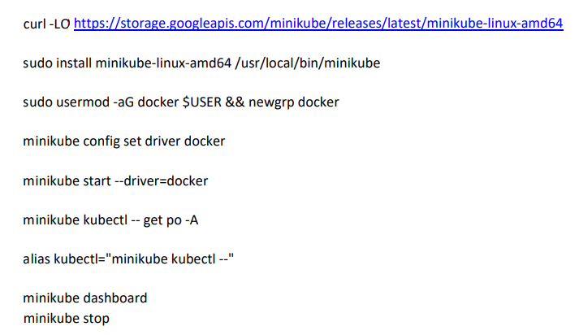
Task 2-2: Setting Up Minikube with Docker Driver
Efficiently configure and utilize Minikube with Docker as the driver for local Kubernetes development and testing.

Slide 15
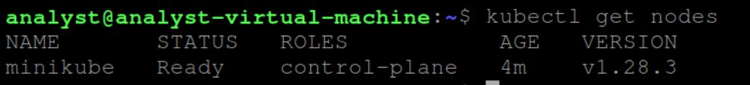
Task 2-3: Status of MiniKube
This commands is to fetch the information of the nodes in the cluster

Slide 16
Task 2-3 : Status of jenkins deployment pod
Deploys the Jenkins application on the Kubernetes cluster using the provided configuration.
Ensures a smooth and monitored rollout of the Jenkins deployment.

Slide 17
Task 3 : Provision Jenkins Master pod in kubernetes cluster

Slide 18
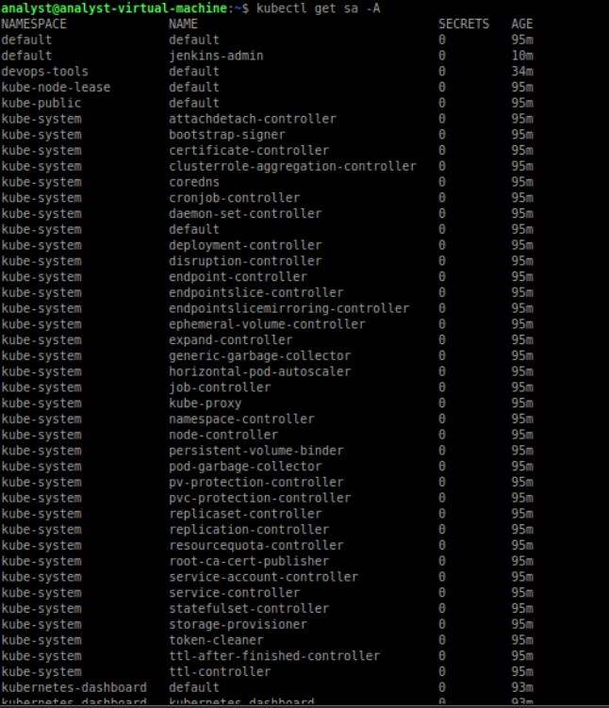
Task 3 - 1: Service Account
Lists details about Service Accounts in all namespaces within the Kubernetes cluster.

Slide 19
Task 3 -2 : Create Persistent Storage
Lists details about both Persistent Volumes and Persistent Volume Claims within the Kubernetes cluster.

Slide 20
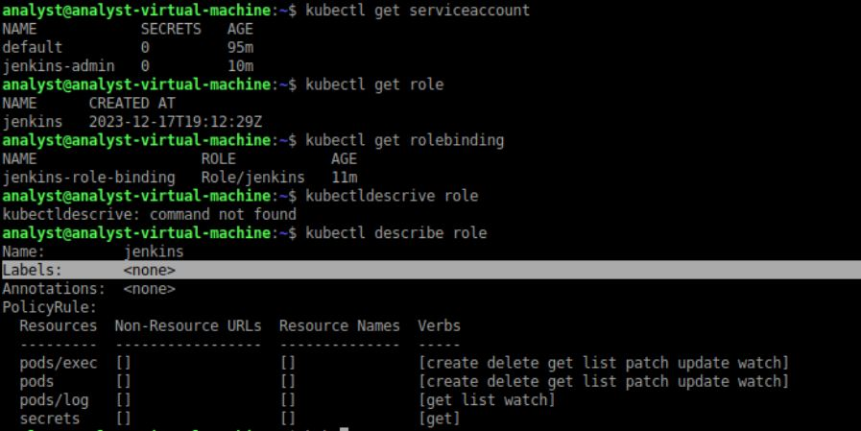
Task 3 - 3: Service account

Slide 21
Task 3 - 4: Pod deployment and expose service

Slide 22
Task 4 : Configurations of jenkins and installation of all necessary plugins

Slide 23
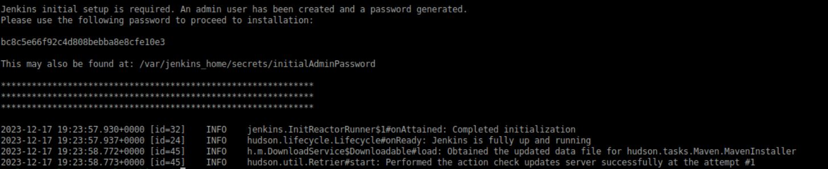
Task 4 - 1 : jenkins generated password

Slide 24
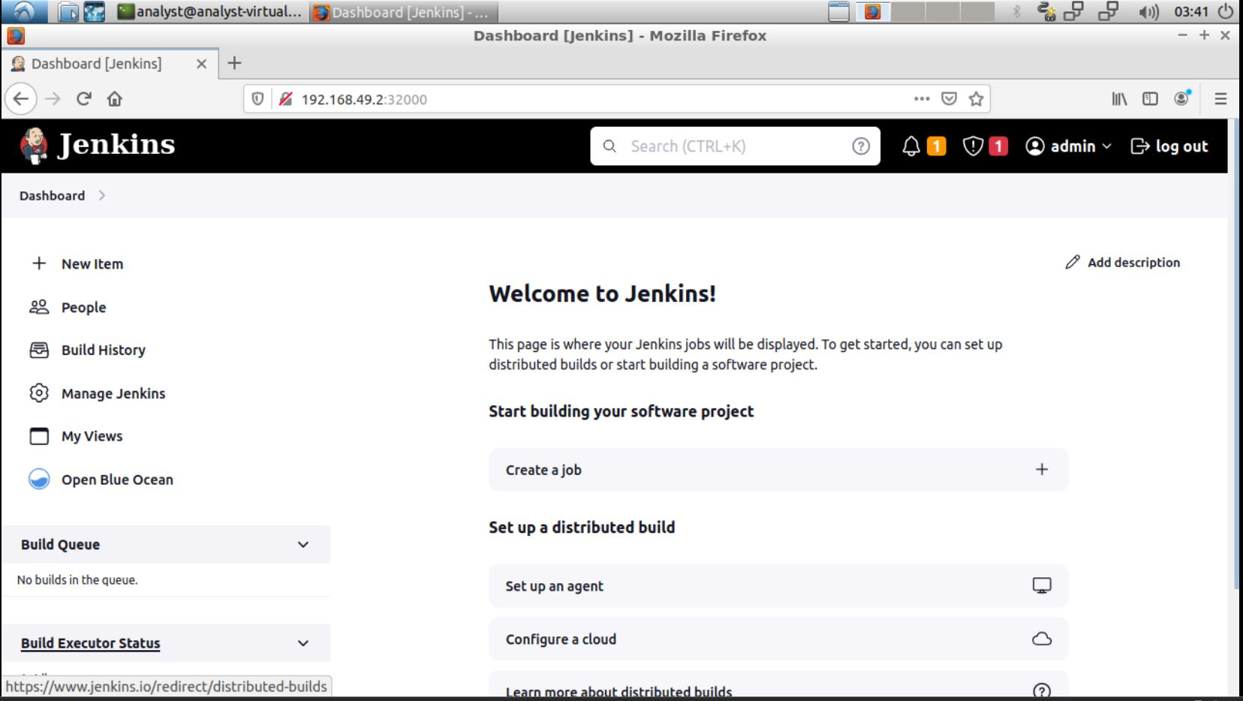
Task 4 - 2 : Accessing jenkins with the exposed port

Slide 25
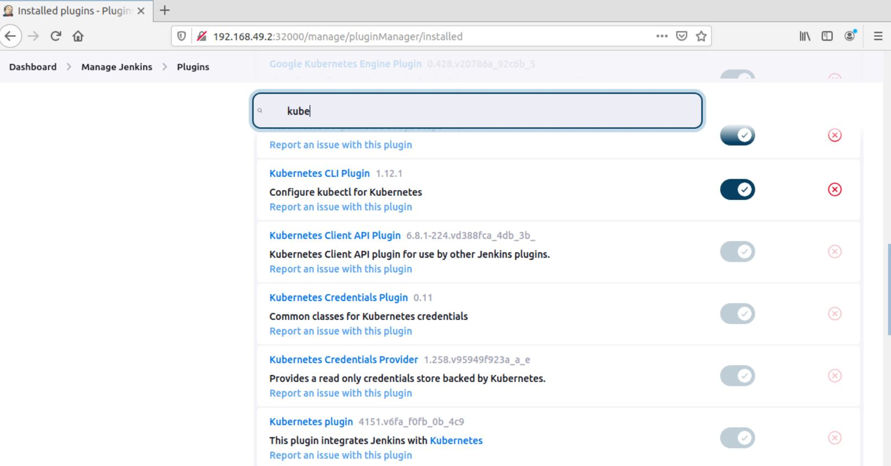
Task 4 - 3 : jenkins plugin installation
Installing Kubernetes Plugins

Slide 26
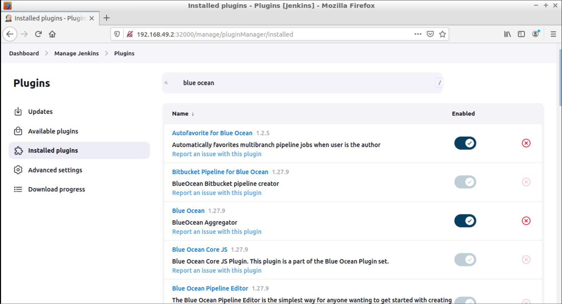
Task 4 - 3 : jenkins plugin installation
Blue Ocean Plugins Installation

Slide 27
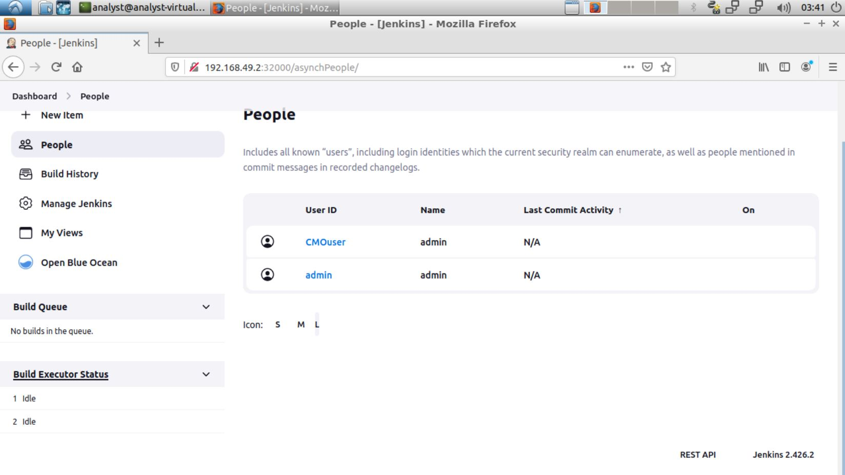
Task 4 - 4 : creating an admin user
Creating Admin User
CMOuser

Slide 28
Task 5 : Jenkins agent image with python support

Slide 29
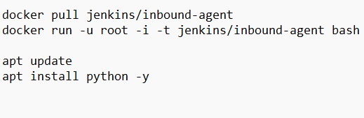
Task 5.1~5.3 :Setting Up Jenkins Inbound Agent with Docker
Pulls the Jenkins Inbound Agent image to enable communication with a Jenkins controller.
Sets up and runs the container, providing a bash shell inside the Jenkins Inbound Agent container.
Installs Python within the container for potential automation tasks.

Slide 30
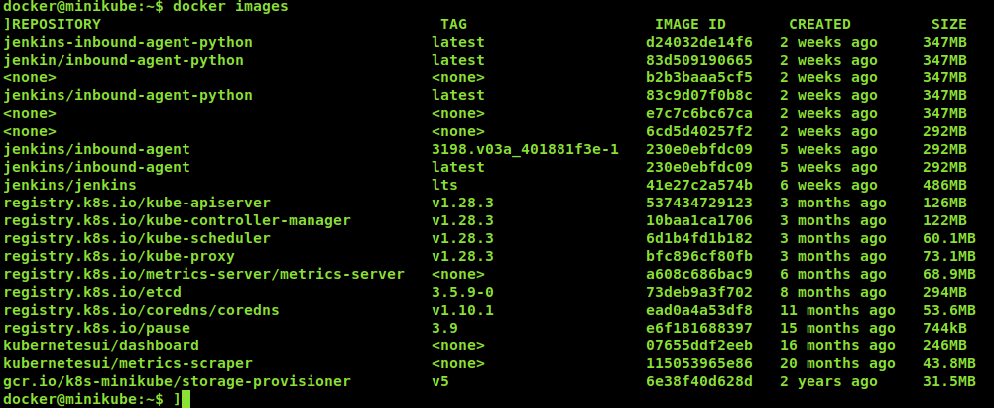
Task 5.4:Managing Docker Images and Tagging
Managing and organizing Docker images on the local machine.

Slide 31
Task 6 : git to manage python script changes

Slide 32
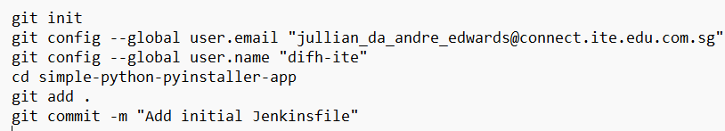
Task 6 : Initializing and Committing to Git Repository
Sets up a new Git repository for version control.
Configures user email and name for accurate commit attribution.
Stages and commits initial changes to the project.

Slide 33
Task 7 : creation of python script with menu selection for system status monitoring

Slide 34
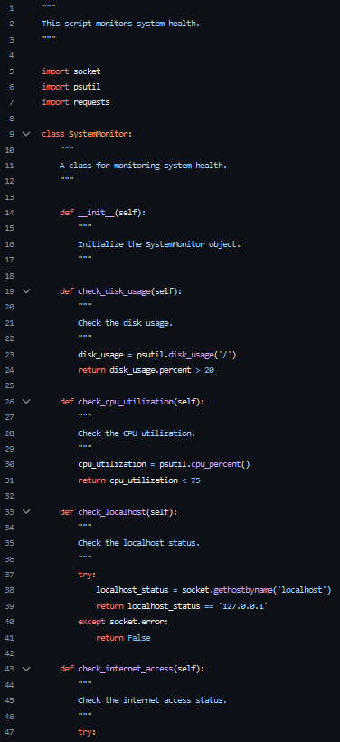
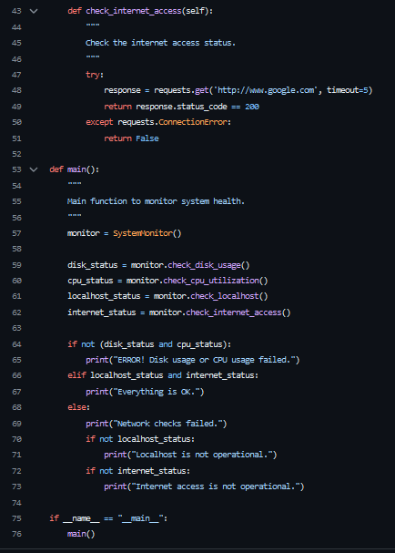
Task 7.1~7.2:python system status monitoring
This is to create a python script for executes health checks and provides informative output.
Checks disk usage, CPU utilization, localhost status, and internet access.
Prints appropriate messages based on the results.

Slide 35
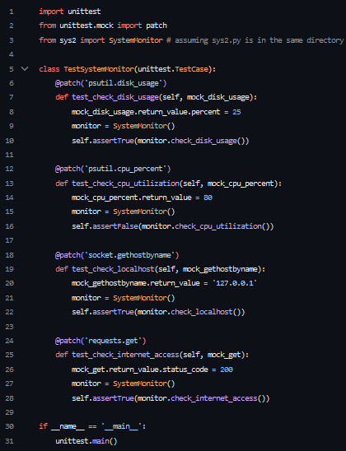
Task 7.3: Unit Testing System Monitoring Functions
Unit testing ensures the reliability of code by validating individual components.
Enables the identification of potential issues early in the development process.
Verifying the correctness of system monitoring functions.

Slide 36
Task 8 : creation of multistage jenkins pipeline to integrate, test and deploy the python script

Slide 37
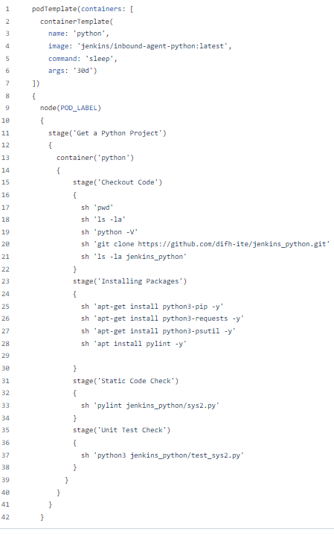
Task 8: Various stages of pipeline
Objective: Builds a Python project within a Jenkins pipeline.
Tools: Utilizes Jenkins pipeline syntax and Docker containers.
Stages
Get a Python Project:
Checkout Code:
Print working Directory and list files
Verifies Python version.
Clones the Python project repository
Lists contents of the cloned directory
Installing Packages:
Install Python3-pip , Python3-requests, Python3-psutil , and Pylint using apt.
Static Code Check :
Run pylint on a specific Python file ( ‘jenkins_python/sys2.py’).
Unit Test Check:
Executes unit test using ‘ python3 jenkins_python/test_sys2.py)

Slide 38
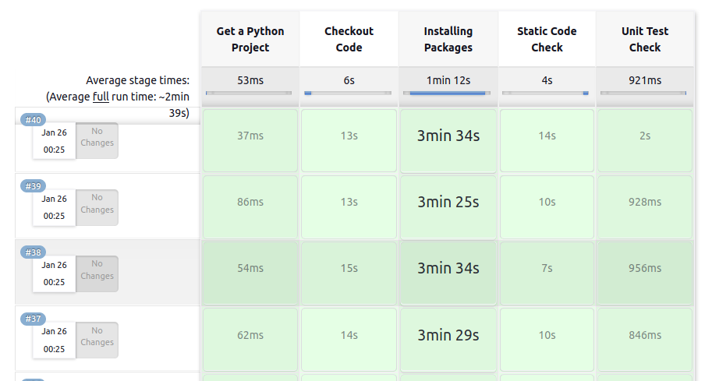
Task 8: Various stages of pipeline

Slide 39
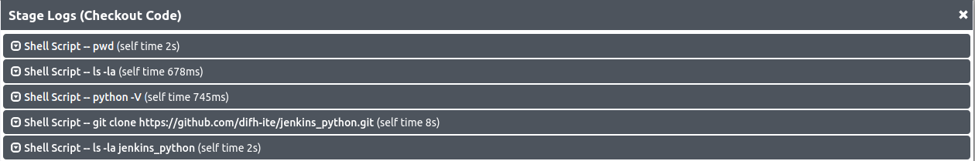
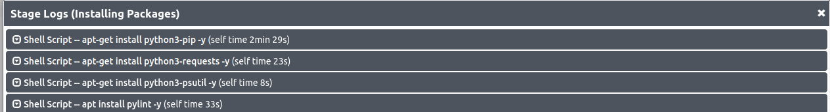
Task 8 : Logs of checkout code & installing packages

Slide 40
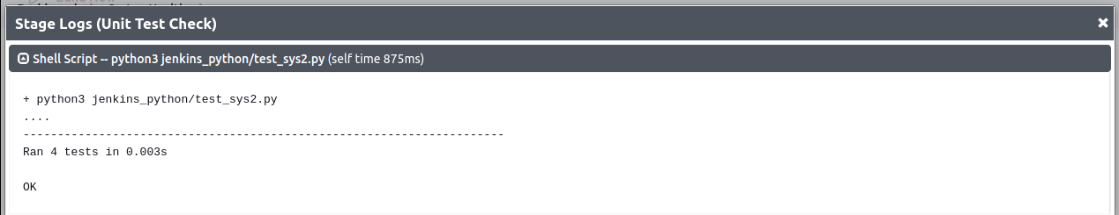
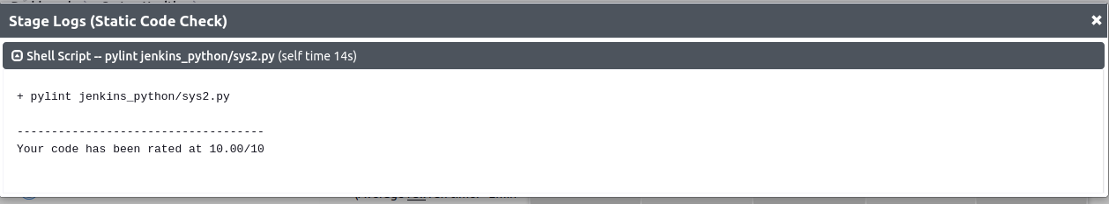
Task 8: Logs of unit test & static code

Slide 41
THANK YOU
Jullian Man Hin Leonard Shariffin

